Slide 1
Modeling Nuclear Fuel Burnup Using Bateman Equations
Abhinand Satish
07-08-2025

Slide 2
Introduction
Nuclear reactors operate by sustaining controlled fission chain reactions that generate heat for power production. As the reactor operates, the composition of nuclear fuel undergoes significant changes due to three primary mechanisms:
Fission reactions splitting heavy nuclei
Neutron capture transforming isotopes
Radioactive decay of unstable nuclei
Accurately tracking these compositional changes is essential for predicting reactor performance ensuring safety margins and optimizing fuel cycles.

Slide 3
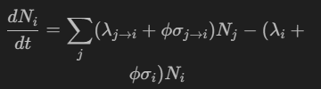
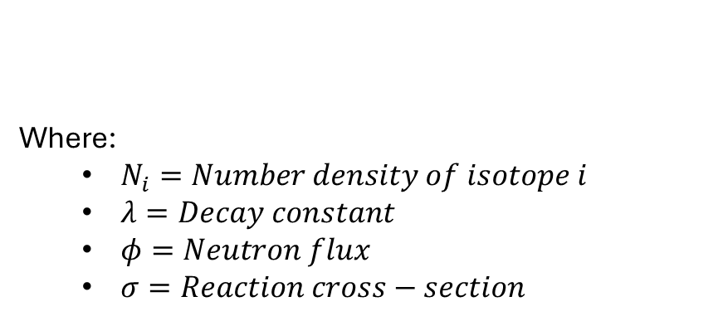
Theoretical Background: The Bateman equations
The Bateman equations provide a mathematical framework for modeling the time evolution of isotopic concentrations in nuclear fuel. These coupled ordinary differential equations account for:
Radioactive decay chains
Neutron-induced transmutation reactions
Production through fission and capture
Depletion through various reaction pathways
Where:
$N_{i}=Number density of isotope i$
$λ=Decay constant$
$φ=Neutron flux$
$σ=Reaction cross−section$

Slide 4
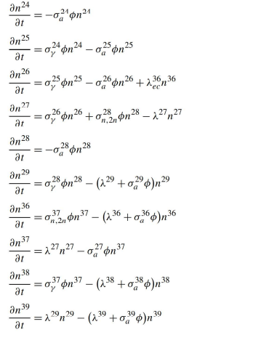
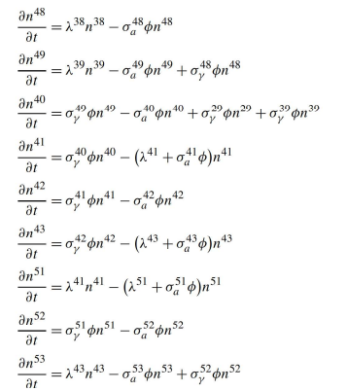
Stacey’s Uranium Burnup ODE’s
Isotope | Code
U234 | 24
U235 | 25
U236 | 26
U237 | 27
U238 | 28
U239 | 29
Np236 | 36
Np237 | 37
Np238 | 38
Np239 | 39
Pu238 | 48
Pu239 | 49
Pu240 | 40
Pu241 | 41
Pu242 | 42
Pu243 | 43
Am241 | 51
Am242 | 52
Am243 | 53

Slide 5
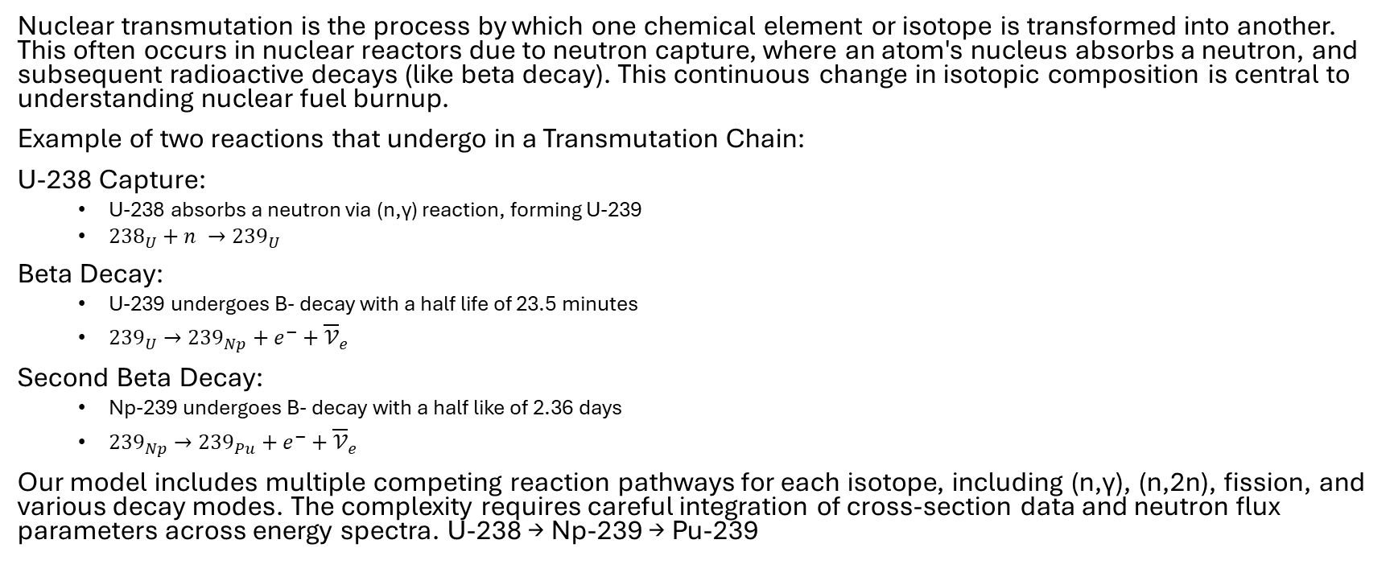
Nuclear Transmutation Chains
Nuclear transmutation is the process by which one chemical element or isotope is transformed into another. This often occurs in nuclear reactors due to neutron capture, where an atom's nucleus absorbs a neutron, and subsequent radioactive decays (like beta decay). This continuous change in isotopic composition is central to understanding nuclear fuel burnup.
Example of two reactions that undergo in a Transmutation Chain:
U-238 Capture:
U-238 absorbs a neutron via (n,γ) reaction, forming U-239
${238}_{U}+n →{239}_{U}$
Beta Decay:
U-239 undergoes B- decay with a half life of 23.5 minutes
${239}_{U}→{239}_{Np}+e^{−}+{\overline{𝒱}}_{e}$
Second Beta Decay:
Np-239 undergoes B- decay with a half like of 2.36 days
${239}_{Np}→{239}_{Pu}+e^{−}+{\overline{𝒱}}_{e}$
Our model includes multiple competing reaction pathways for each isotope, including (n,γ), (n,2n), fission, and various decay modes. The complexity requires careful integration of cross-section data and neutron flux parameters across energy spectra. U-238 → Np-239 → Pu-239

Slide 6
Code Structure Overview
Input Processing
Parses time units (seconds, minutes, hours, days, years)
Reads time intervals, evaluation steps, and flux profiles
Loads initial isotopic composition vector
Imports cross-section libraries and decay constants
Pre-processing
Normalizes all time units to seconds for consistent calculation
Constructs time evaluation vector (t_eval) based on user parameters
Normalizes and scales neutron flux to specified power level
Builds transition matrix from cross-section and decay data
ODE Solution
Implements ODE system for Bateman equations
Utilizes solve_ivp with BDF method for stiff systems
Handles adaptive time-stepping for stability
Implements sparse matrix techniques for large isotope sets

Slide 7
ODE system code definition
def odes(t, y, evaluation_flux):
"""
ODE system for burnup model using effective cross sections.
y: vector of concentrations for each isotope.
"""
dNdt = np.zeros_like(y)
for i, iso in enumerate(isotope_list):
production = isotopes[iso]['prod']
depletion = isotopes[iso]['loss']
gain = 0.0
loss = 0.0
for iso, rxn in production:
if rxn == 'decay':
gain += nuclear_data[rxn][iso]*y[index_map[iso]]
else:
gain += (nuclear_data[rxn][iso]*evaluation_flux).sum()*y[index_map[iso]]
for iso, rxn in depletion:
if rxn == 'decay':
loss += nuclear_data[rxn][iso]*y[index_map[iso]]
else:
loss += (nuclear_data[rxn][iso]*evaluation_flux).sum()*y[index_map[iso]]
dNdt[i] = gain-loss
return dNdt

Slide 8
Problem 1 results – Final Concentrations
Reason for difference in Final outputs
My code implements 3 primary reactions:
(n,γ), (n,fission), and (n,2n)
Origen2 includes (n,p), (n,α), spontaneous fission, beta-delayed neutron emission, and photonuclear reactions
Example 1 input file
Isotopes : U235, U238
Isotope masses (g) : 71.0, 9929.0
Time units : d
Time intervals : 180, 60, 180, 60, 180, 60
Time step : 10
Flux fractions : 1.0E-00, 1.0E-10, 1.0E-00, 1.0E-10, 1.0E-00, 1.0E-10
Total flux : 8.0E+15
Time (d) | U234 | U235 | U236 | U237 | U238 | U239 | Np236 | Np237 | Np238 | Np239 | Pu238 | Pu239 | Pu240 | Pu241 | Pu242 | Pu243 | Am241 | Am242 | Am243 | Total mass(g)
720 | 0.00E+00 | 2.26E+01 | 5.96E+00 | 1.45E-04 | 6.05E+03 | 0.00E+00 | 6.93E-05 | 2.56E+00 | 0.00E+00 | 9.98E-08 | 6.37E-01 | 5.16E+02 | 5.00E+01 | 2.55E+00 | 1.07E-01 | 0.00E+00 | 6.89E-02 | 6.53E-03 | 3.35E-03 | 6.65E+03
ORIGEN2 - Results
Time (d) | U234 | U235 | U236 | U237 | U238 | U239 | Np236 | Np237 | Np238 | Np239 | Pu238 | Pu239 | Pu240 | Pu241 | Pu242 | Pu243 | Am241 | Am242 | Am243 | Total mass(g)
720 | 2.41E-02 | 2.80E+01 | 8.83E+00 | 2.48E-04 | 8.75E+03 | 0.00E+00 | 2.54E-04 | 4.59E+00 | 2.88E-10 | 1.36E-07 | 1.20E+00 | 6.80E+02 | 7.06E+01 | 3.81E+00 | 1.84E-01 | 0.00E+00 | 1.08E-01 | 1.72E-08 | 7.48E-03 | 9.54E+03

Slide 9
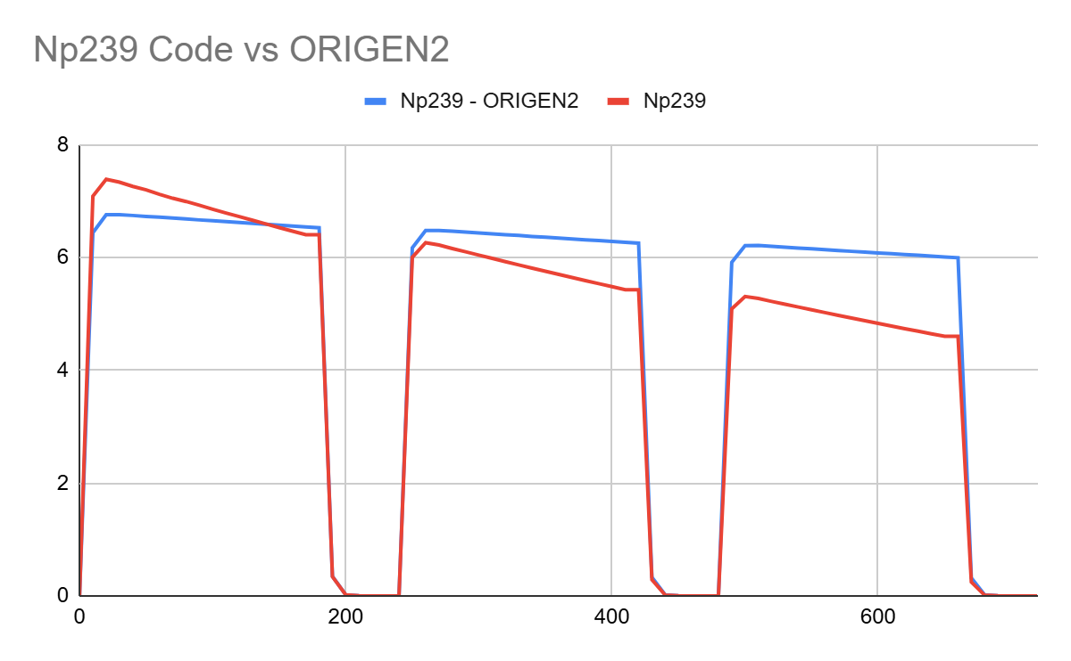
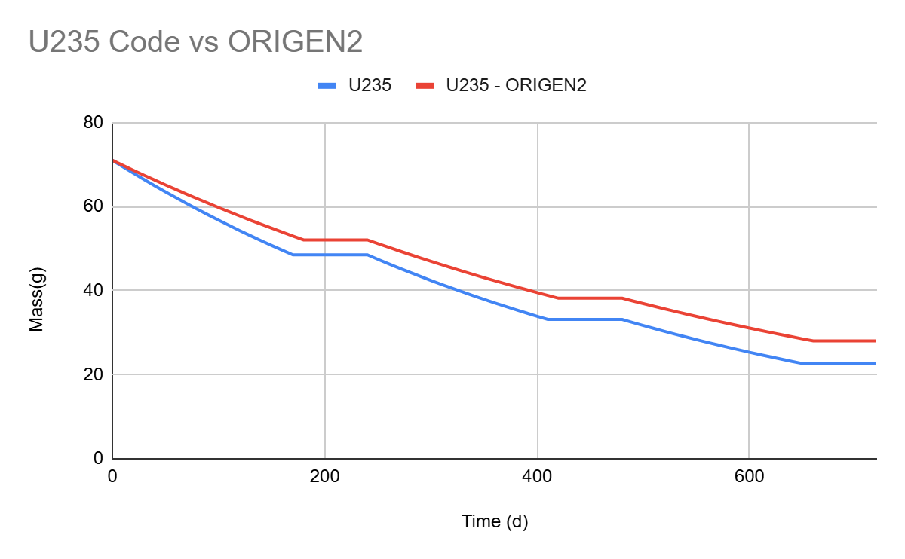
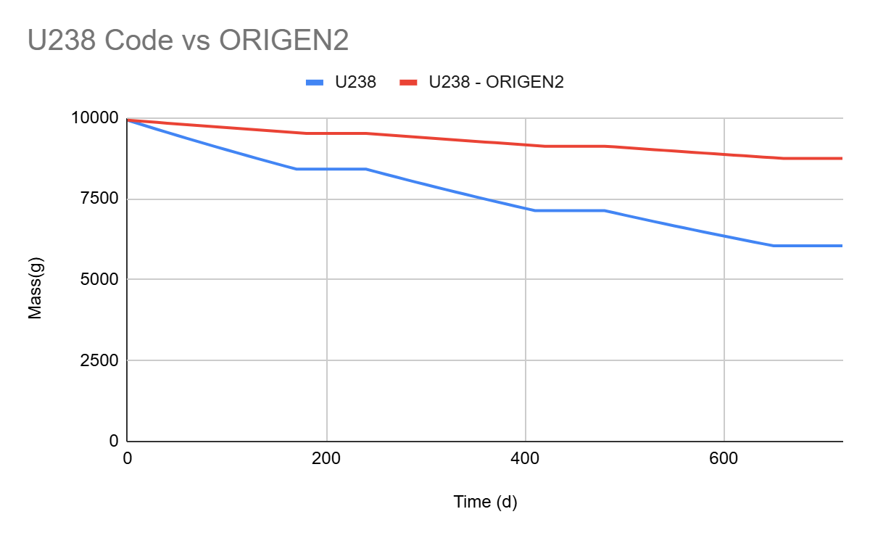
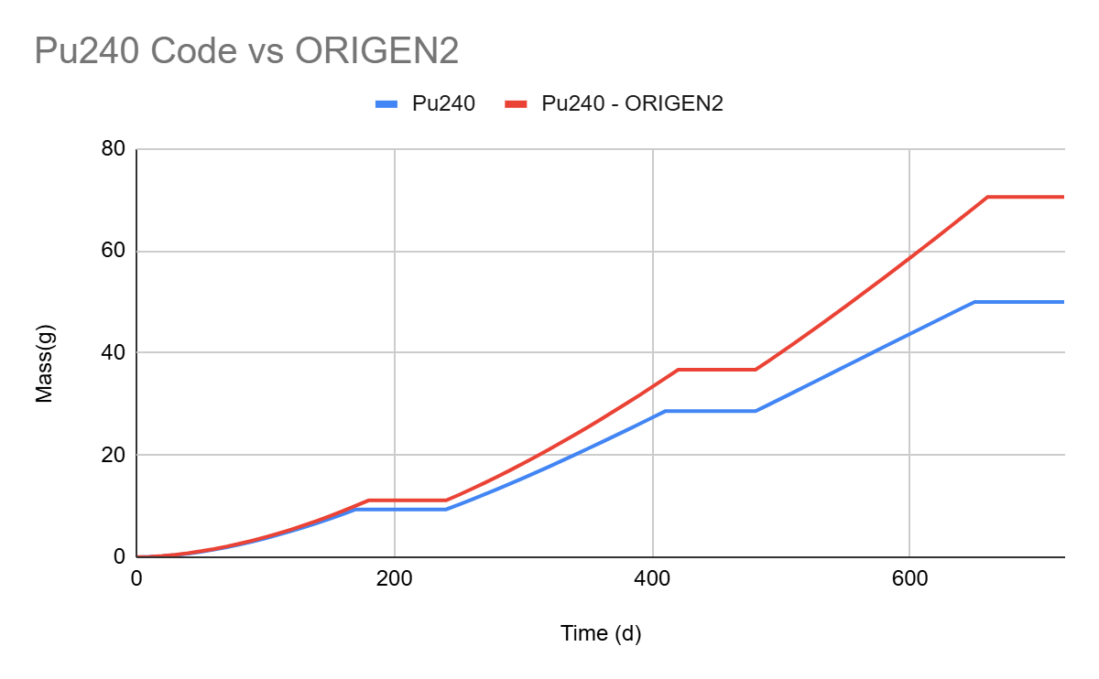
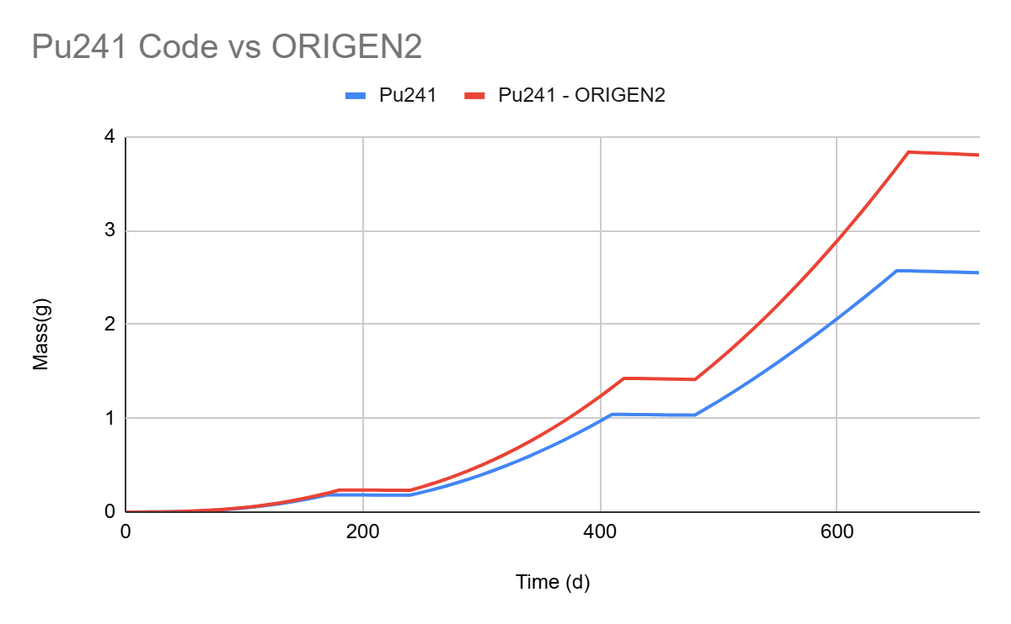
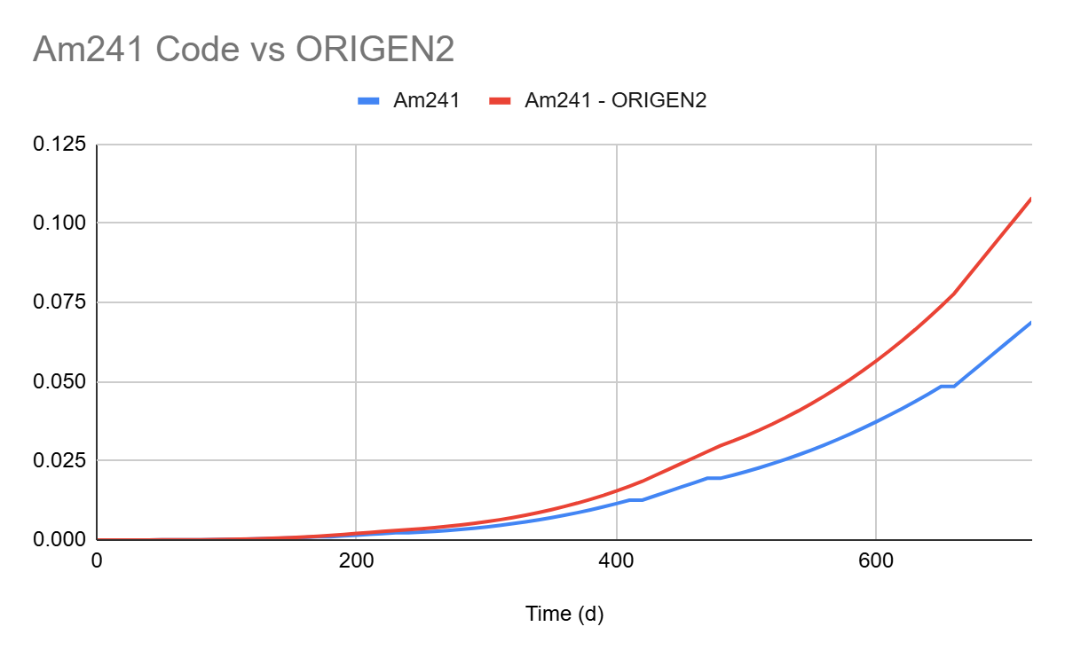
Problem 1 Output Comparison

Slide 10
Problem 2 results – Final Concentration
Reason for difference in Final outputs
My code implements 3 primary reactions:
(n,γ), (n,fission), and (n,2n)
Origen2 includes (n,p), (n,α), spontaneous fission, beta-delayed neutron emission, and photonuclear reactions
Example 2 input file
Isotopes :Pu239, Pu240, Pu241, Pu242
Isotope masses (g) : 6500.0, 2500.0, 700.0, 300.0
Time units : d
Time intervals : 180, 60, 180, 60, 180, 60
Time step : 10
Flux fractions : 1.0E-00, 1.0E-10, 1.0E-00, 1.0E-10, 1.0E-00, 1.0E-10
Total flux : 8.0E+15
Time (d) | U234 | U235 | U236 | U237 | U238 | U239 | Np236 | Np237 | Np238 | Np239 | Pu238 | Pu239 | Pu240 | Pu241 | Pu242 | Pu243 | Am241 | Am242 | Am243 | Total mass(g)
720 | 0.00E+00 | 0.00E+00 | 0.00E+00 | 0.00E+00 | 0.00E+00 | 0.00E+00 | 0.00E+00 | 0.00E+00 | 0.00E+00 | 0.00E+00 | 0.00E+00 | 2.12E+03 | 1.84E+03 | 3.64E+02 | 2.29E+02 | 0.00E+00 | 2.73E+01 | 6.71E+00 | 2.49E+01 | 4.61E+03
ORIGEN2 - Results
Time (d) | U234 | U235 | U236 | U237 | U238 | U239 | Np236 | Np237 | Np238 | Np239 | Pu238 | Pu239 | Pu240 | Pu241 | Pu242 | Pu243 | Am241 | Am242 | Am243 | Total mass(g)
720 | 2.76E-02 | 1.49E-01 | 4.94E-01 | 1.77E-05 | 1.15E-03 | 0.00E+00 | 3.30E-06 | 8.89E-02 | 2.07E-07 | 3.58E-05 | 5.40E+00 | 2.75E+03 | 2.48E+03 | 4.94E+02 | 3.06E+02 | 0.00E+00 | 3.92E+01 | 1.47E-05 | 4.16E+01 | 6.12E+03

Slide 11
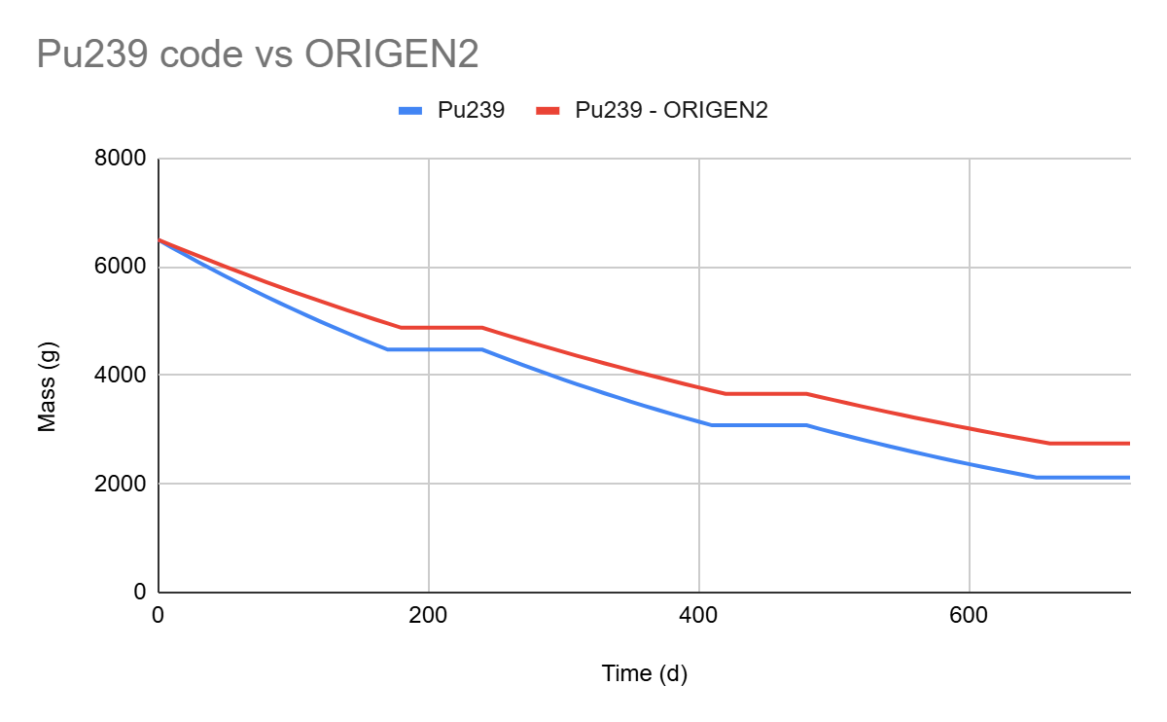
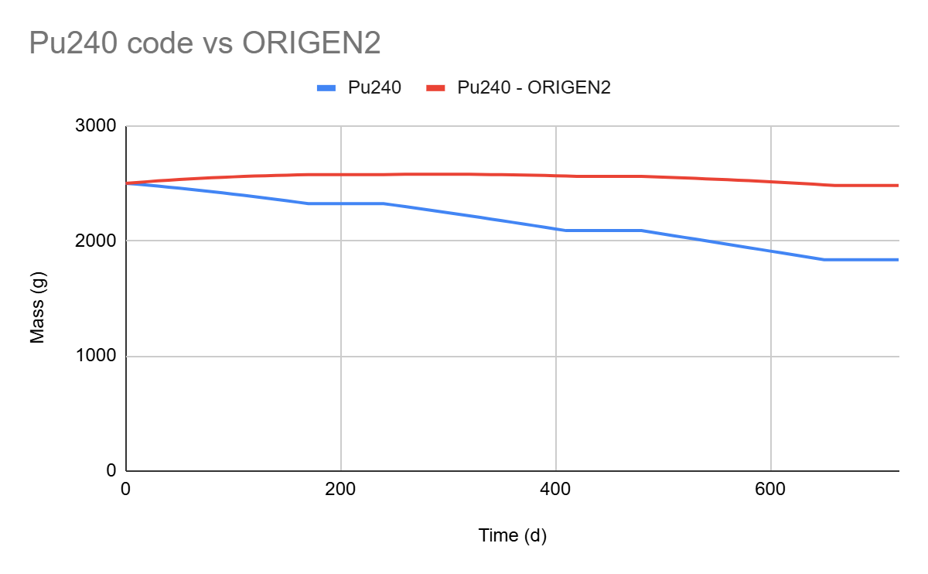
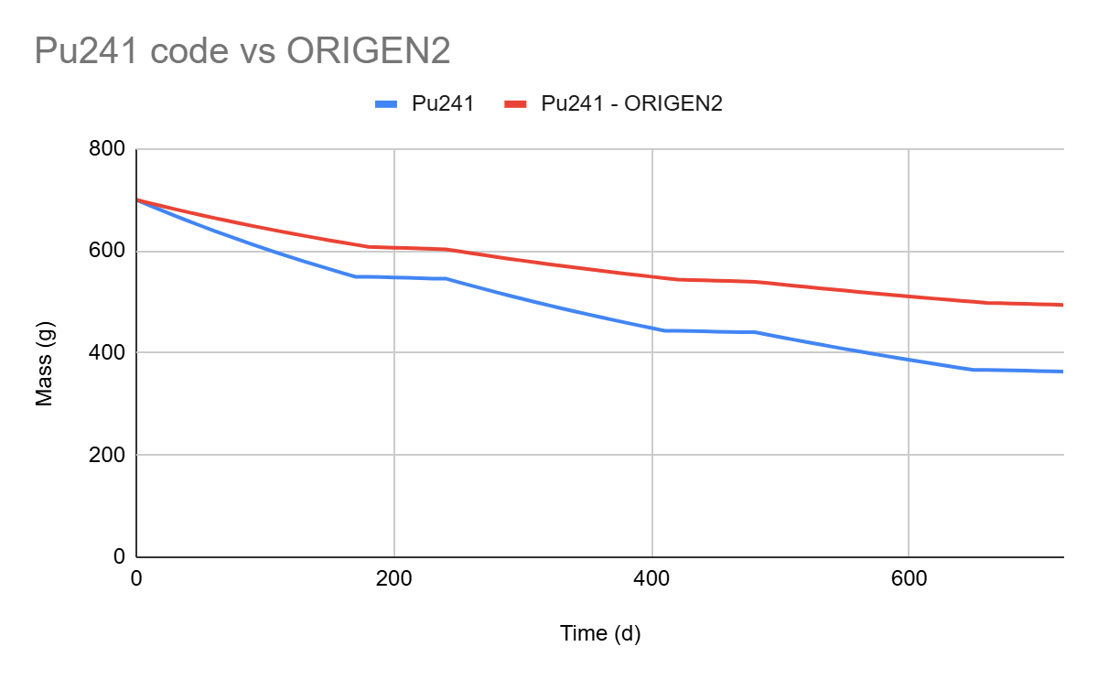
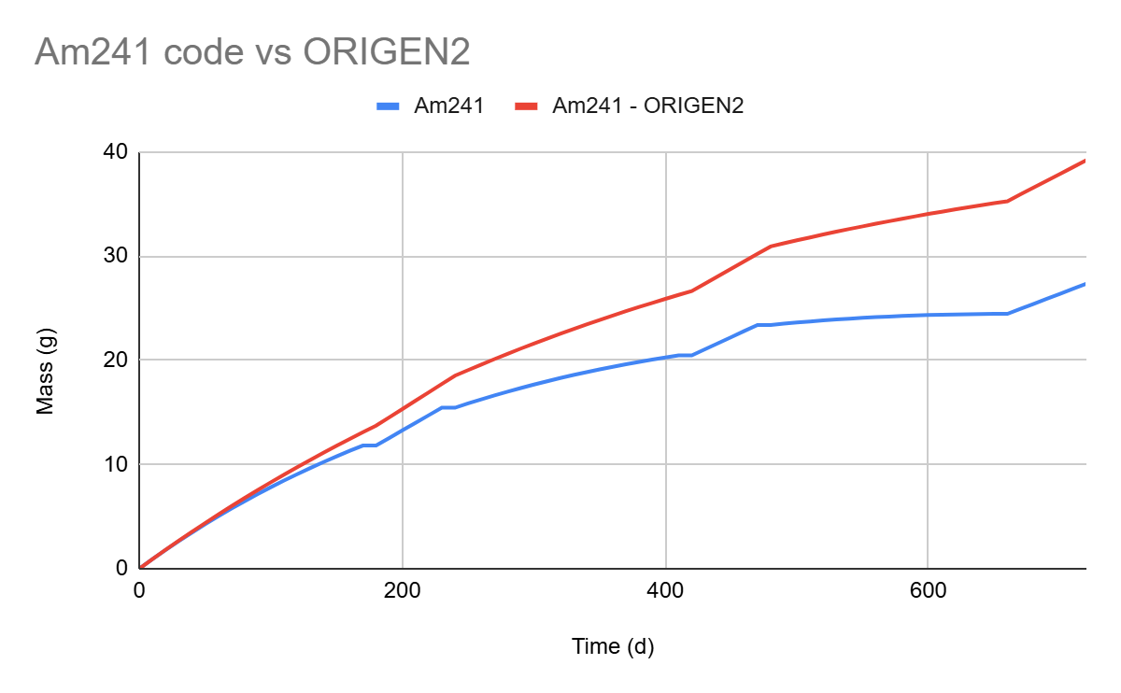
Problem 2 Output Comparison

Slide 12
Problem 3 results – Final Concentration
Example 3 input file
Isotopes : U235, U238, Pu239, Pu240, Pu241, Pu242
Isotope masses (g) : 56.3, 7873.7, 1345.5, 517.5, 144.9, 62.1
Time units : d
Time intervals : 180, 60, 180, 60, 180, 60
Time step : 10
Flux fractions : 1.0E-00, 1.0E-10, 1.0E-00, 1.0E-10, 1.0E-00, 1.0E-10
Total flux : 8.0E+15
Time (d) | U234 | U235 | U236 | U237 | U238 | U239 | Np236 | Np237 | Np238 | Np239 | Pu238 | Pu239 | Pu240 | Pu241 | Pu242 | Pu243 | Am241 | Am242 | Am243 | Total mass(g)
720 | 0.00E+00 | 1.79E+01 | 4.73E+00 | 1.15E-04 | 4.80E+03 | 0.00E+00 | 5.50E-05 | 2.03E+00 | 0.00E+00 | 7.92E-08 | 5.05E-01 | 8.48E+02 | 4.20E+02 | 7.73E+01 | 4.75E+01 | 0.00E+00 | 5.72E+00 | 1.40E+00 | 5.17E+00 | 6.23E+03
ORIGEN2 - Results
Time (d) | U234 | U235 | U236 | U237 | U238 | U239 | Np236 | Np237 | Np238 | Np239 | Pu238 | Pu239 | Pu240 | Pu241 | Pu242 | Pu243 | Am241 | Am242 | Am243 | Total mass(g)
720 | 2.48E-02 | 2.23E+01 | 7.10E+00 | 2.01E-04 | 6.94E+03 | 0.00E+00 | 2.02E-04 | 3.66E+00 | 4.31E-08 | 7.52E-06 | 2.07E+00 | 1.11E+03 | 5.70E+02 | 1.05E+02 | 6.35E+01 | 0.00E+00 | 8.20E+00 | 3.06E-06 | 8.62E+00 | 8.83E+03

Slide 13
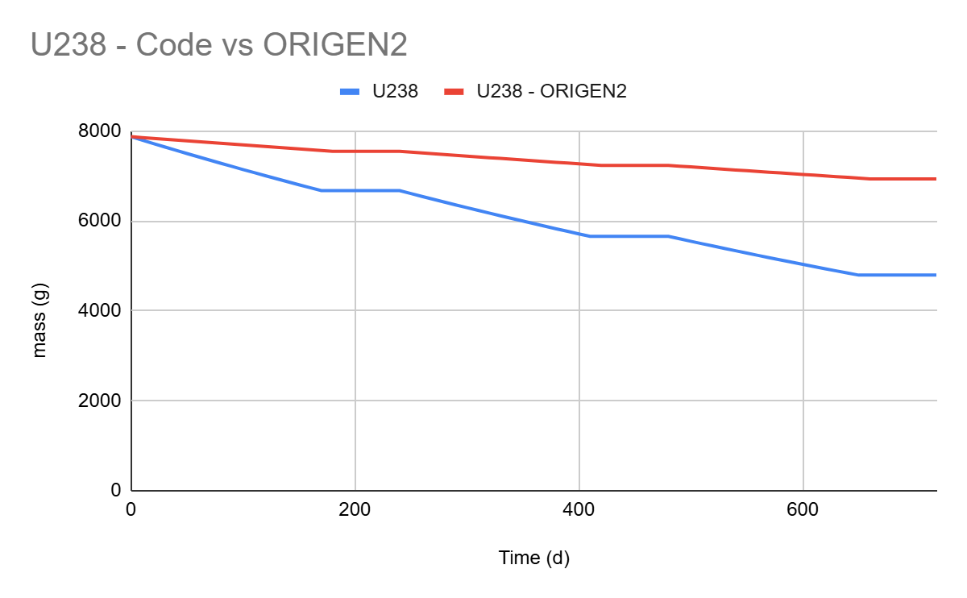
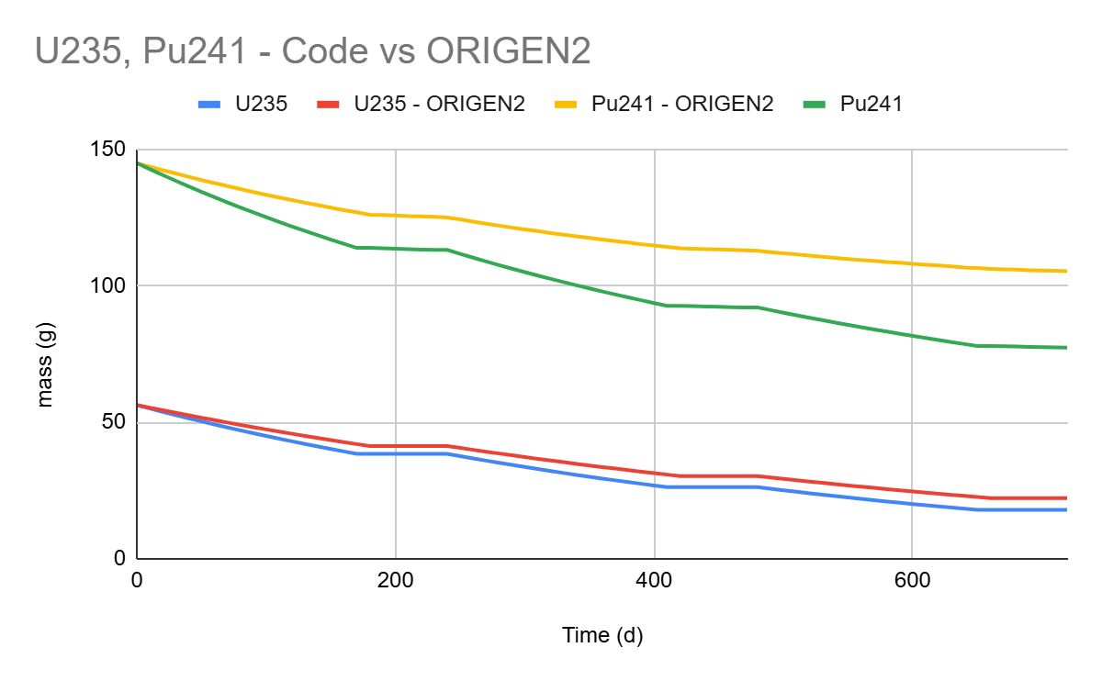
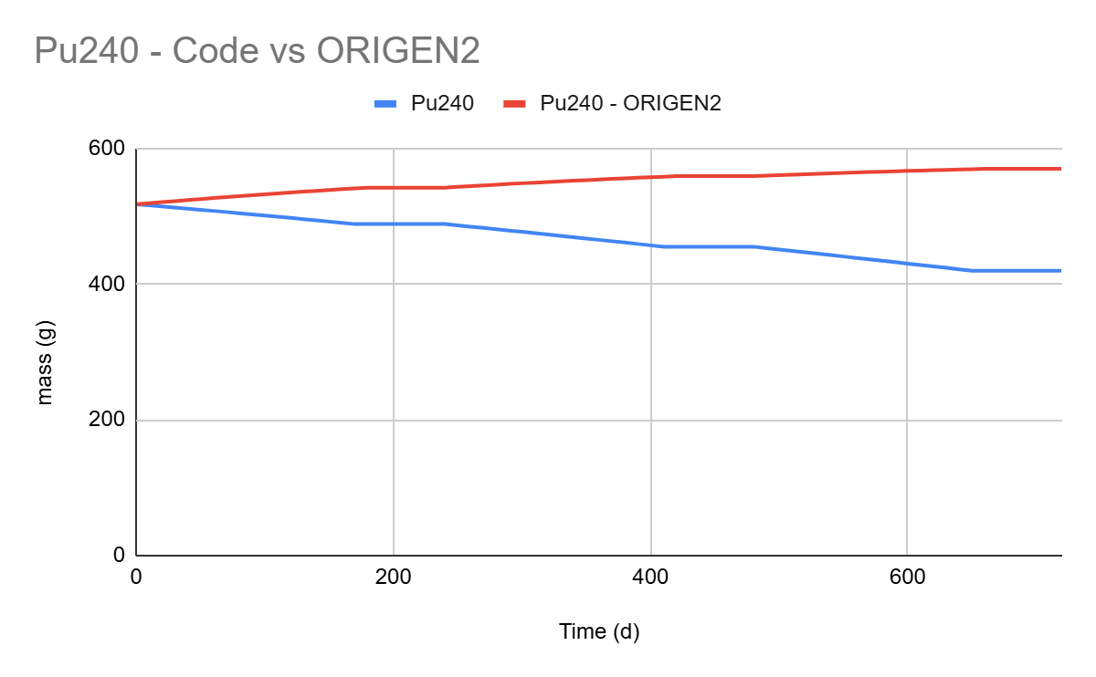
Problem 3 Output Comparison

Slide 14
Conclusion and Future work
Model implementation
Successfully developed a comprehensive simulation model for tracking isotope evolution during nuclear fuel burnup using the Bateman equation framework.
Technical Challenges
In this project, most of the technical Challenges were over complicating the ODE function generator. I could have simplified the code earlier to organise the loss and production terms but I over complicated each loss and production terms.
Integrating the cross section into the dictionary to make accurate calculations was hard from a coding stand point but was understandable from a technical stand point.
Validation
The trend of the results were aligned with the trend of the ORIGEN 2 code. Only issue is that my code simplicity did not take into account all factors leading to a high concentration mass in the ORIGEN 2 code mass concentration outputs.

